Slide 1
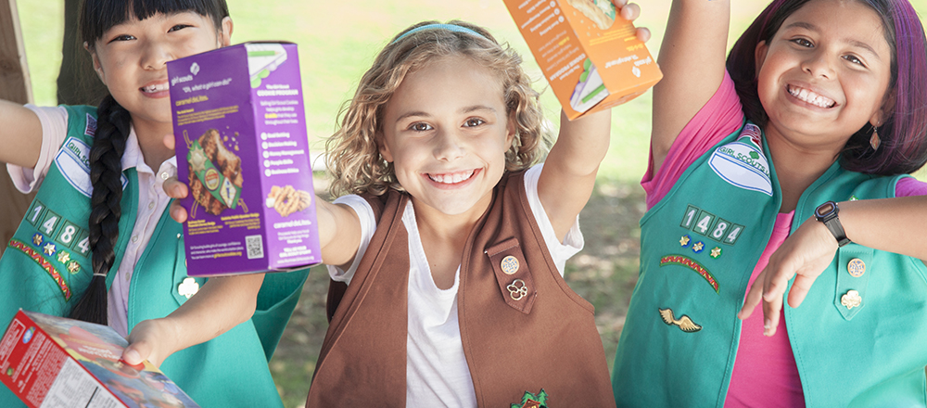
New Troop Cookie Coordinator Training
Notes:
This slide style is TITLE STYLE A
NOTES FOR USAGE:
Adjust width and position of the white title box as needed.
Photos:
Some pre-sized images have been supplied with the template.
To change photos, select image > right click > “Change picture”.
Check out Girl Scouts photo library here: https://gsusa.box.com/s/bpioz0pyf8d40knlau8m
Avoid using Microsoft clip art: it’s off-brand and tends to look outdated and unprofessional.
If using your own photography, make sure you have secured rights to use in Girl Scout materials.
Crop and resize an image by double clicking the image. The crop tool appears in the Formatting Palette. Click on the crop tool to make adjustments.
Girl Scout Councils:
Replace the Girl Scout servicemark with your council lockup in Master page view (view > Master > Slide Master).

Slide 2
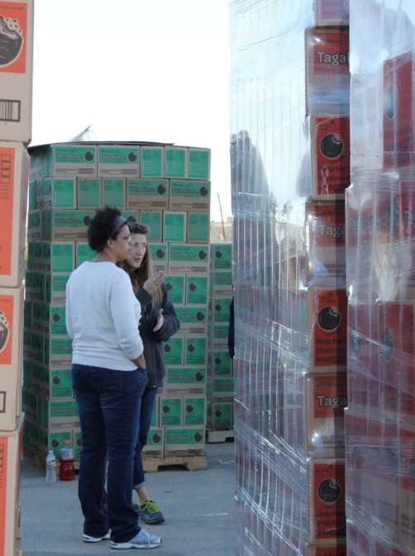
We’re Here to Help! Service Unit Information
Cookie Manager:
Phone:
Email:
Booth Manager:
Phone:
Email:

Slide 3
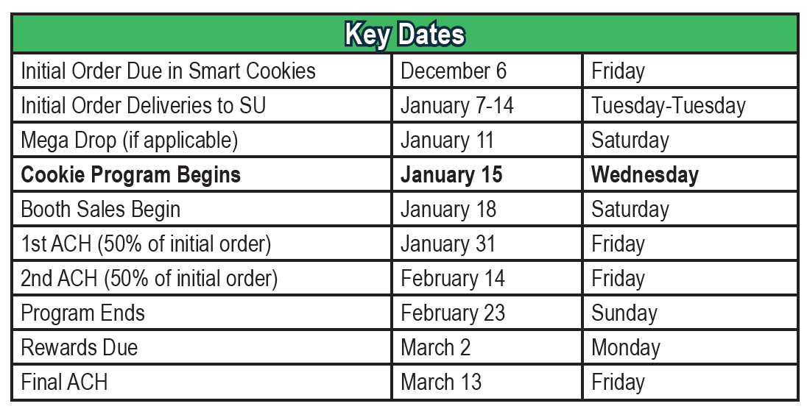
Key Dates
**November 11th ACH Forms due:
NEW troops and
Troops that changed bank account from the 2019 Cookie Sale.

Slide 4
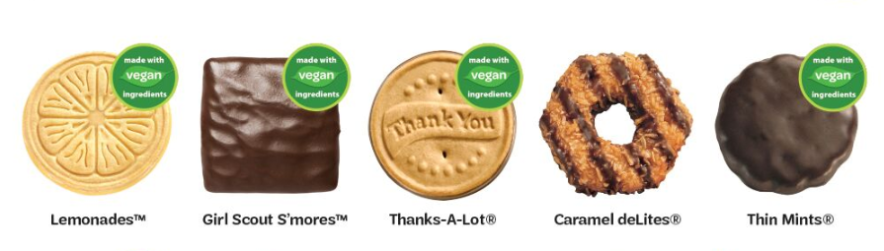
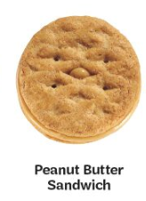
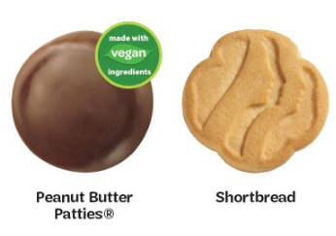
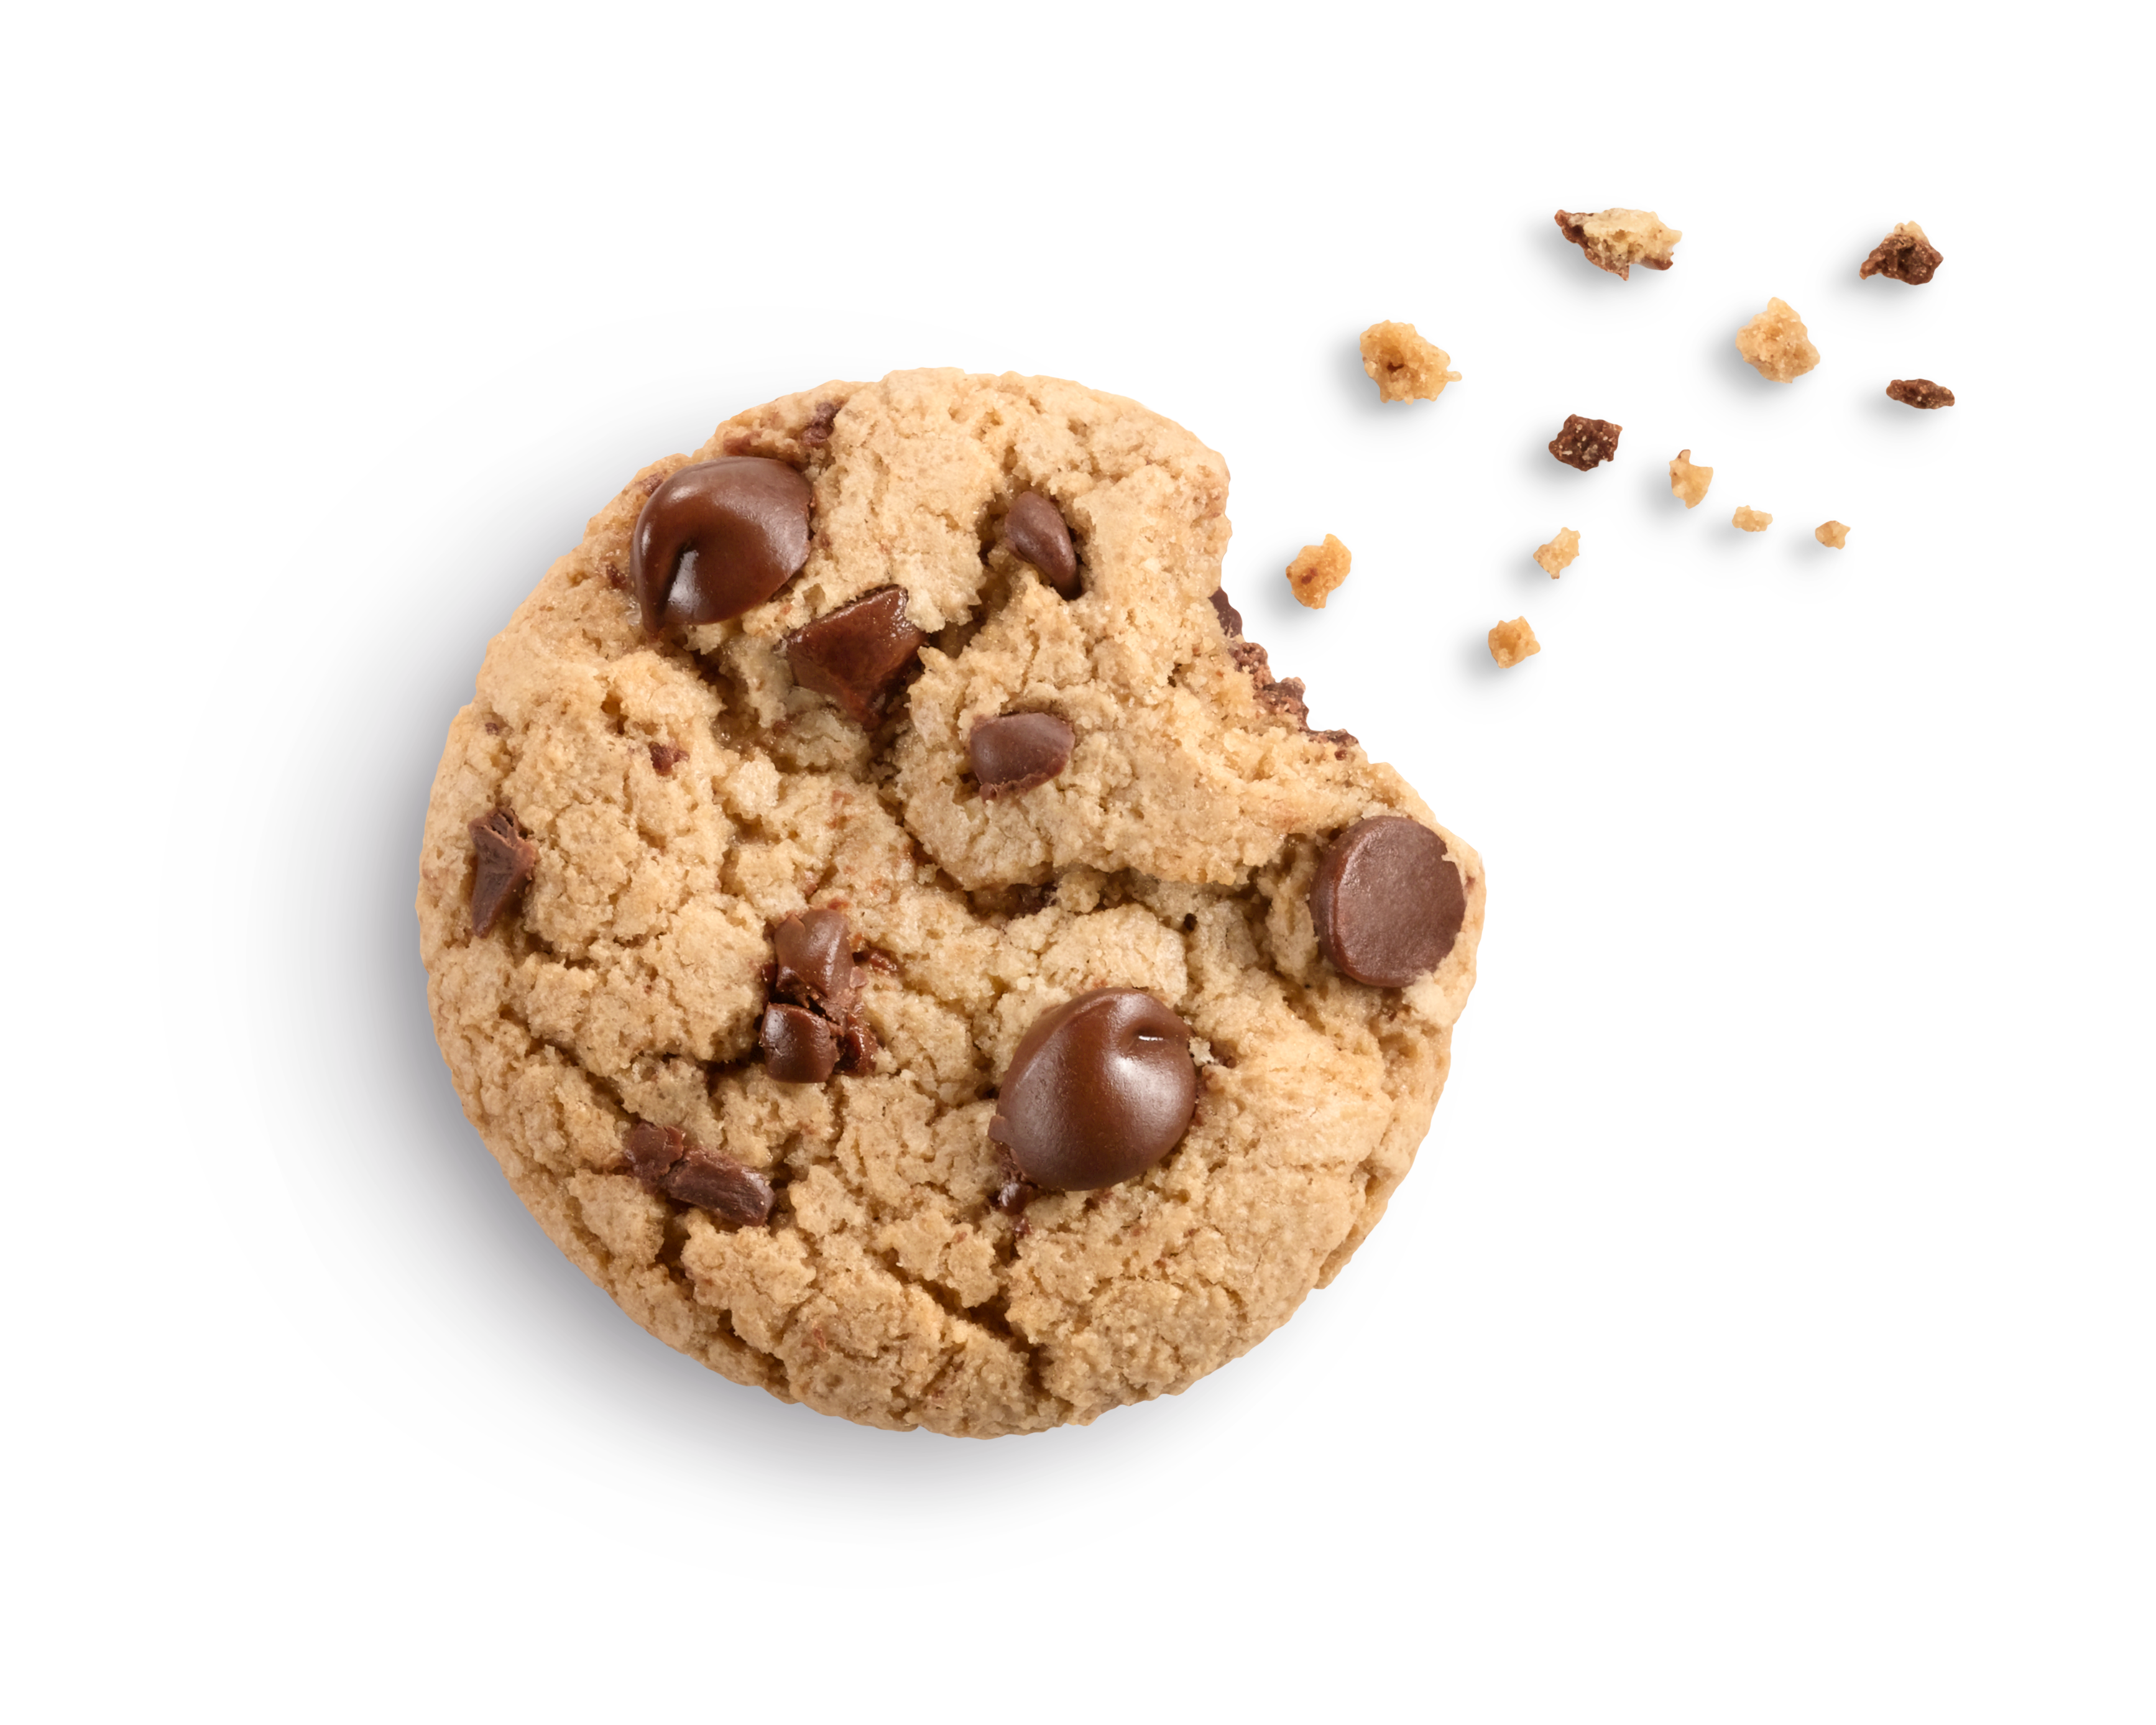

Cookie Line Up- All cookies are $4 except for Gluten Free those are $5
Gluten Free Caramel Chocolate Chip

Slide 5

Thanks-A-Lot Update
2020 is the last year for Thanks-A-Lot’s!!
There will be a new cookie in 2021…stay tuned!

Slide 6
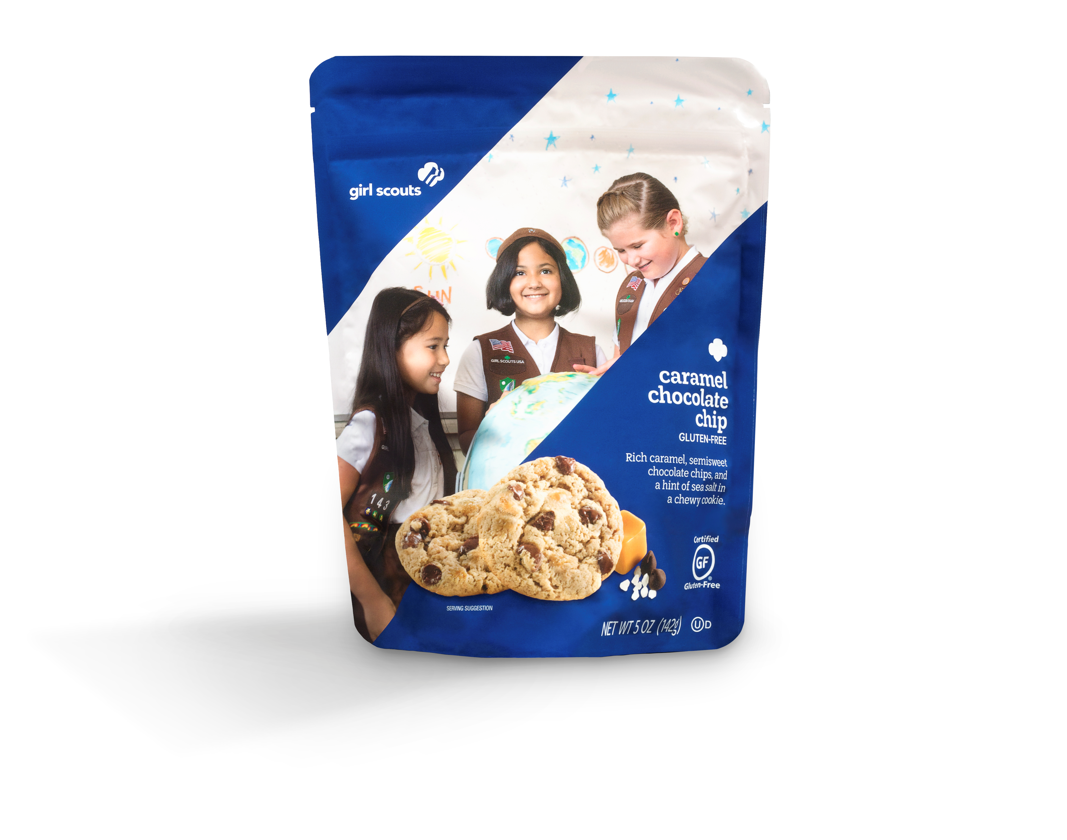
2019-20 Gluten Free: Caramel Chocolate Chip
$5 per package
No extras in warehouse
No Returns!
No reorders
Your SU will let you know how to place this order in Smart Cookies (if applicable)

Slide 7
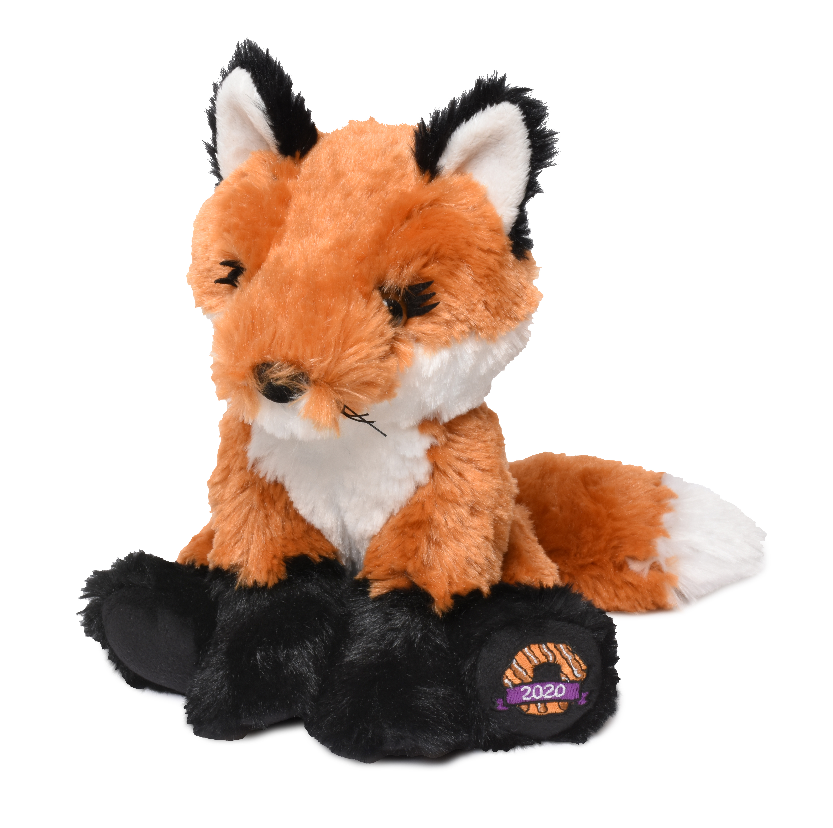


Theme & Mascot
Meet Fiona
The Red Fox
Foxes in general are known for their cleverness, but the Red Fox adds the distinction of being uniquely adaptable to different environments—and able to thrive virtually anywhere, from remote areas in the Arctic to African farms to the suburbs of North America.
Clever, curious and organized,
she has been a prominent character in literature and folklore. Recently, it has been used as a character in children’s movies.

Slide 8
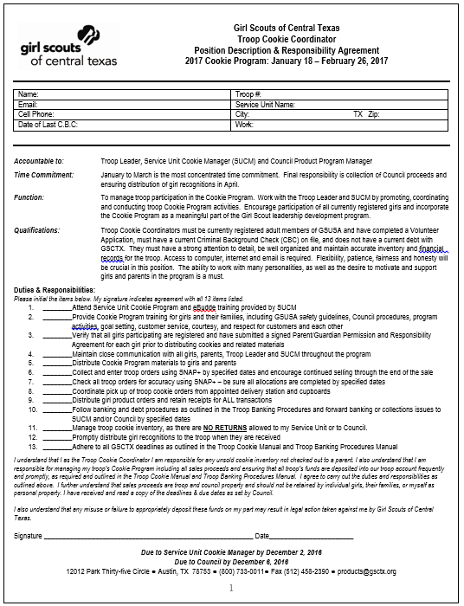
Troop Cookie Coordinator (TCC) Position Description
Purpose of Position:
  To ensure the opportunity for girls
  to participate in the Cookie Program
Accountability:
  Works with and reports to
  the Service Unit Cookie Manager
Responsibilities:
  Attend training
  Train parents and girls
  Follow policies and use provided resources
  Manage troop inventory
  Keep proper records using receipts
  Report accurately and often in Smart Cookies
  Distribute materials/rewards promptly
Form is ONLINE only! When submitting must include SUCM’s email address so they receive a copy.

Slide 9
Before the Sale

Slide 10

Responsibilities Before the Cookie Sale
Set up Smart Cookies
  Enter complete contact info for troop
  Verify that all girls are in the system
    You will not be able to add or delete any girls
    GSCTX will not delete any non-participating girl, you will just leave them at 0 during the sale
    If you are missing girls, you will need to fill out the Google Form: https://forms.gle/wDJ9Sk19KcmJgFQq7
Set up Parent/Girl Training
  Train all parents and girls
  Go over important information (refer to Troop Manual for sample agenda)
Set a troop goal and plan how to get meet the goal!

Slide 11

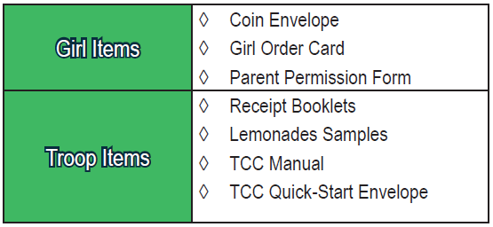

Materials & Location of Additional Resources
Items you will receive:
www.gsctx.org/en/cookies/about-girl-scout-cookies.html: Council website with all GSCTX related manual, toolkits, parent and troop resources
Parent Guide will be available for parents to download and print.
www.abcbakers.com: public site, ABC Bakers overview, recipes, nutritional information, FAQ’s
ABC Bakers YouTube Channel- Smart Cookie Instructions-Address not in manual
  www.youtube.com/user/ABCCouncils
  Just look up ABC Bakers on YouTube
Smart Cookies screenshots available at the beginning of Nov. on www.gsctx.org.
www.abcsmartcookies.com: Secure site, personalized based on user, order management, girl experience, training, marketing

Slide 12

Why participate in Cookie Sale?
5 Skills girls are Learning
Goal Setting
Decision Making
Money Management
People Skills
Business Ethics
New Cookie Entrepreneur Family Pin
Replaces the Cookie Pin
Girls earn one pin per grade level
Pin is now customized to each grade level
Purchase in the shop
Each level has requirements to earn

Slide 13
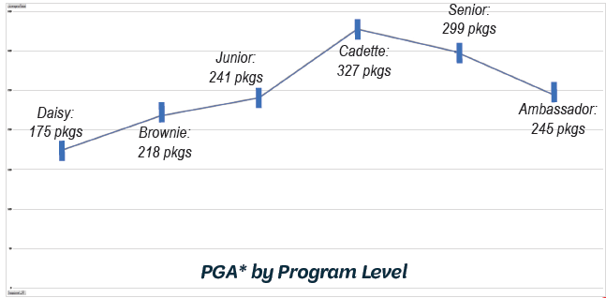
Troop and Girl Goals
Returning troops should review last year’s total sales.
New troops should view the per girl averages (PGA) by age level to help with setting a goal
Review the Initial Order Tool to calculate how many cookies to order (SU will email out)

Slide 14
Training Girls & Parents
Things to discuss with Parents:
Set up a parent meeting
Hand out materials
Parent permission forms are legal documents!
Review important dates: NO pre-sales!!
Set expectations for paperwork, picking up cookies, and turning in money
Discuss:
  Safety
  Goal setting
  Rules for door-to-door sales
    No commercial areas or common areas
    Apartment rules
  Rules for booth sales / Booth etiquette
  On-line marketing rules
  Financial responsibility / Money handling
REMINDER: Girls Sell Cookies, not Parents!!
Use part of a troop meeting
Teach the cookies
  Names; types; colors
  Cost
Discuss the 5 skills, goal setting
Discuss safety
  Must wear uniform
  Buddy system, always with an adult
  Never approach cars
  Never go inside a house
Talk about Gift of Caring options
  Operation Cookies (donated to military)
  Helping Hero (local organization- If participating pick one as a group)
Teach booth etiquette
Talk about rewards

Slide 15
Safety Guidelines & Program Procedure (refer to manual for more detail)
Safety Guideline
Go over safety guidelines with girls and parents.
Drive thru booths are not allowed
Adults that handle money, cookies and/or around any Girl Scout that is not their own, must be registered AND have a Criminal Background Check (CBC) on file.
Program Procedure
Girls must be registered BEFORE November 30th.
Girl and Troops cannot sell/take orders before January 15
Must sell cookies at the GSCTX price ($4 and $5 for Gluten Free)
Individuals, members or non-members, may not violate any policy of Girl Scouts of USA, GSCTX, nor any federal/state or local ordinance/law when selling GS Cookies.

Slide 16
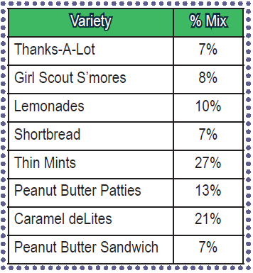
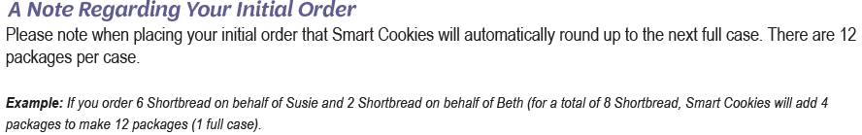
Placing Initial Order
Due in Smart Cookies by December 6 at 11:59 PM
Review Recommended Order by Variety
Overall order is in cases (12 packages=1 case)
You order by each girl and that is in packages
Assign at least 1 package to each girl participating
Suggested Initial Order= 75% of last year’s sales
  Note payment for 50% of the order is due within the first 2 weeks of the sale.

Slide 17

NO RETURNS!!!

Slide 18
Receiving Initial Order
Initial Orders will be delivered to your SU between January 7-14th.
You will receive a notification regarding pick up time and location
If your SU participates in a Council Mega Drop, there will be instructions on when/where and how to pick a time slot for pick up.
Must count cookies
Must sign a receipt for cookies
Must keep a copy of the receipt

Slide 19
During The Sale

Slide 20
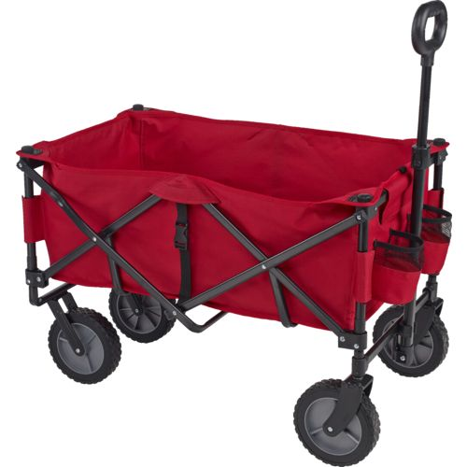
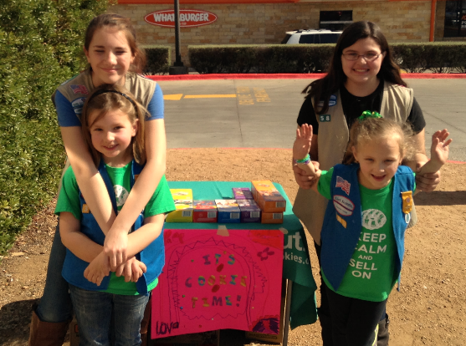

How Do Girls Sell Cookies?
Door to Door/ Wagon Sales
Booths
On-lines Sales-through Smart Cookie Direct Ship
Gift of Caring Program
  Operation Cookie (Virtual Cookie Share)

Slide 21
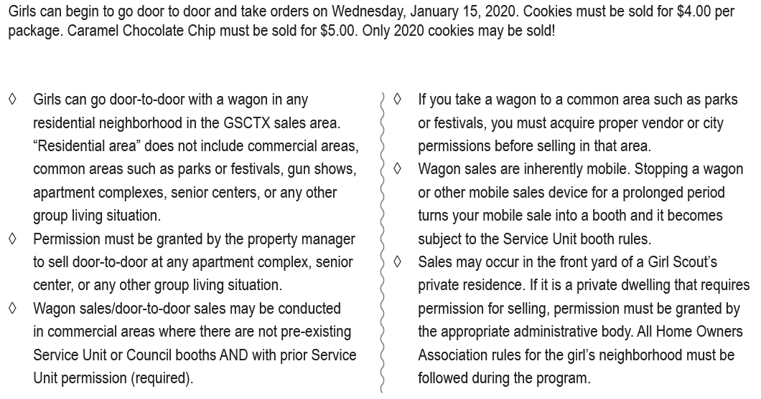
Door to Door & Wagon Sales- the basics

Slide 22
Booth Basics: Booth Sales begin Jan. 18-Feb. 23rd
Anytime you are stationary, you are a booth
Booths can only be set up and distributed by the Service Unit
  “exception”: booths within an organization which must be open to all girls who are members
  Private property (driveway) tables
Make sure that your parents know what booth they are going to and know the rules / etiquette for booth sales
Make sure they know any specific information for that booth
Money is adult responsibility but teach money skills at age appropriate level
  Any adult handling money, product and/or around a Girl Scout that is not their own must be registered AND have a criminal background check (CBC) on file.

Slide 23
Booth Rules / Etiquette
Must have 2 girls and 2 adults
  Senior/Ambassador can have 1 girl and 1 adult
  Cadettes can have 1 girl and 1 adult (IF SU has enough booths to offer)
  Daisies must sell with a mentor older girl troop (Cadette, Senior, Ambassador)
    Cookie Captains need service hours and are great mentors!
All booth chaperones must be registered and CBC’d
NEW: Two dads may work a booth together with their own Girl Scout. At no time should dad of girl A leave girl A with dad of Girl B. Each dad should always be with their own Girl Scout.
NEW: Parents may work together at a booth with their own Girl Scouts (siblings)
NEW: Daisies are not limited to 2 booths the entire program. They may staff more based on Cookie Captain availability

Slide 24
Booth Rules / Etiquette
Be on time
Bring your own table, signs, decorations
Have enough change for the whole shift
Girls must wear uniform
Dress for the weather: most booths are outside
Girls may never approach cars
Be courteous: teach girls to say “thank you” even if people do not buy
Girls/adults may not sit during the sale
  If a chair is needed a written request must be submitted to the SUCM & SUBM
Take all trash with you

Slide 25
Booth Rules / Etiquette (cont.)
No eating/drinking (water bottles are ok if kept under or behind the table)
Cell phones are for square readers only
No tagalongs: siblings, friends, pets
Don’t count the money at the booth
Watch your Inventory! Inventory should not be stacked behind your booth, should be under the table
Don’t park in front of the store
Have a problem at a booth?
  Try to handle problem in a courteous manner
  Demonstrate the Girl Scout promise and law in action
  Contact SU Booth Manager or SU Cookie Manager with any major issues

Slide 26
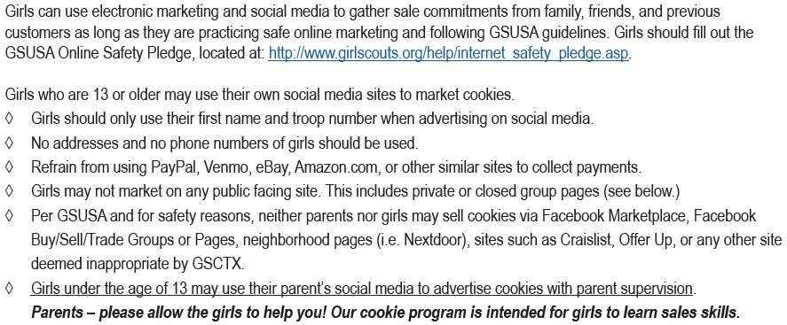
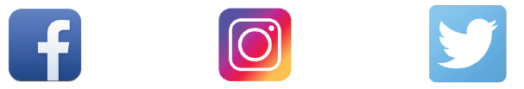
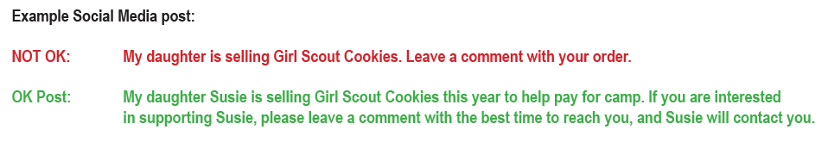
Online Marketing and Social Media
At NO TIME can a parent/guardian post on ANY public forum. Only their own personal social media (not even a personal business page) Don’t do it!!

Slide 27
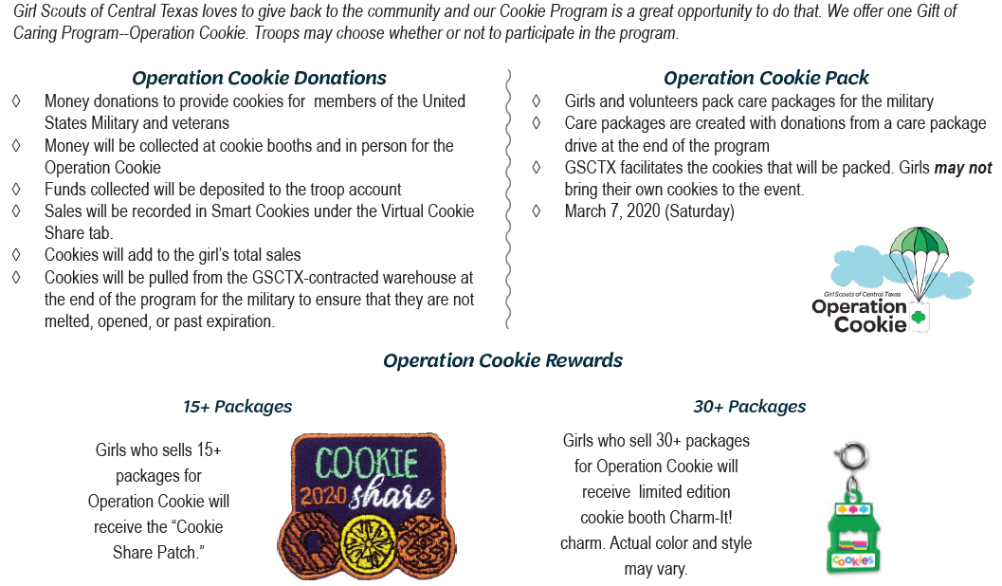
Gift of Caring- Operation Cookie (Virtual Cookie Share)
Troops can still collect physical boxes and donate to a local organization for Helping Heroes. Girl will not earn a prize for it.
Virtual Cookie Share ADDS to the girl/troop totals.

Slide 28
Placing a Planned Order (Re-order)
Troops have an opportunity to re-order cookies throughout the sale.
Planned orders (re-orders)
  Due in Smart Cookies by the deadline set by SU
  Not all SU’s have reorders
  Order is in cases (12 packages=1 case)
  Gluten Free Caramel Chocolate Chip is not an option for reorder
SU will provide a schedule of when orders are due in Smart Cookies
  Order not in Smart Cookies= No cookies available

Slide 29
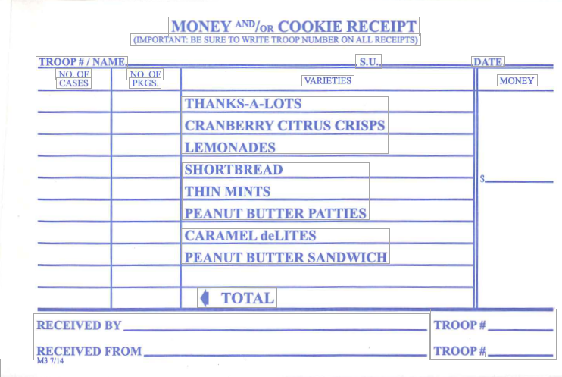
Distribution of Re-Orders to parents
Schedule a location and time for pick up
Separate order by girl
Create receipts for each girl
Name on the receipt should be the GIRL
Signature needs to be from PARENT
You (as the TCC) and the parent/guardian need to count the cookies
Once the count has been verified each person signs the receipt.
  Girls CANNOT sign the receipt
Give the parent/guardian a copy of the receipt and keep a copy for your records.
TIP DO NOT distribute/order more cookies to a parent/guardian if they have not turned in money for cookies they already have.
Every transfer should have a receipt.
If a parent/guardian gives you cookies=1 receipt
If you give parent/guardian cookies=1 receipt
Trades need their own separate receipt
Money turned in=1 receipt

Slide 30
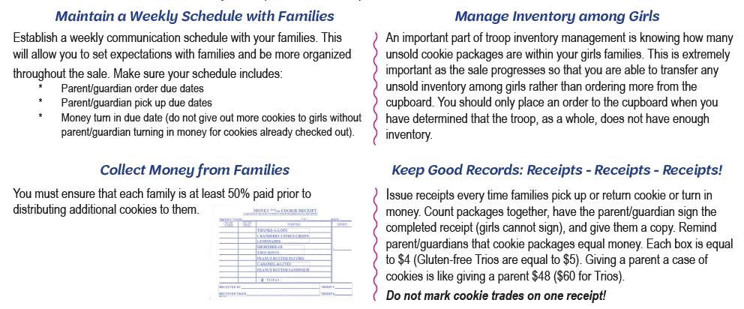
Managing Troop Cookie Inventory
All troop cookie inventory is the financial responsibility of the troop. To maximize your girls’ sales and to minimize the risk of excess cookie inventory at the end of the sale, here are some best practices.
Reminder: GSCTX and SU’s do not accept any returns for cookies ordered.

Slide 31
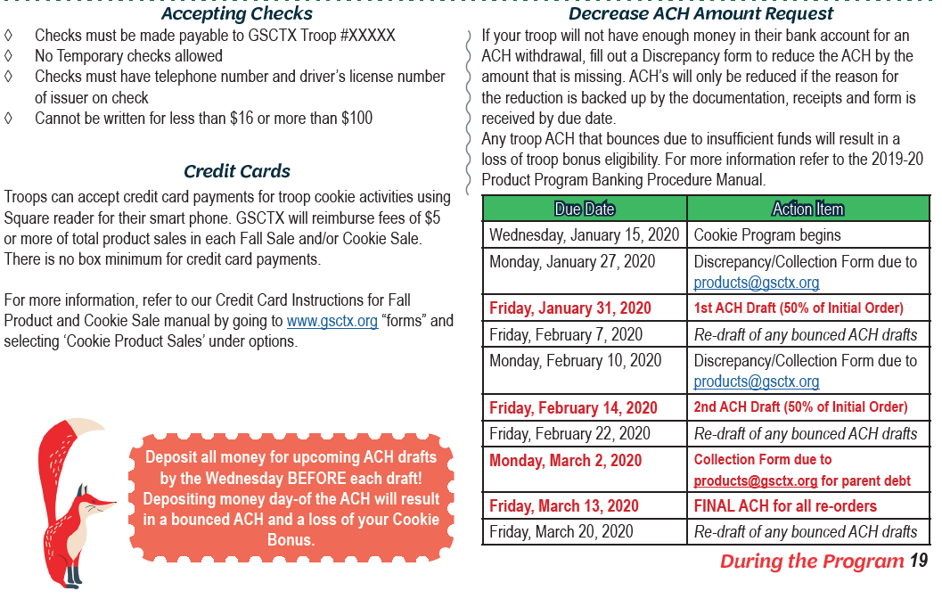
Money Management
Bounced ACH= NO BONUS!
Banking Forms Available:
Discrepancy Form
  NSF checks
  Counterfeit money
  Lower ACH amount
  Lost/Stolen Product/Money
    Note: some cases person is still liable
Collection Form
  Parent Debt
  Troop Debt

Slide 32
Credit Cards
Use Square
  Signup online, link in the Credit Card Manual
Troop pays fee upfront- NEW fee 2.6% + $.10 per transaction
GSCTX will reimburses fees of $5 or more
  Currently working on what the new fees will mean in terms of number of items
Credit Card Manual- will be updated soon to reflect the new changes
Must submit online reimbursement form for reimbursement- Due March 2, 2020

Slide 33
Money Management (Continued)-Refer to Troop Banking Manual for all GSCTX banking procedures
Money should be deposited in the form in which it was received.
Money MUST be deposited into troop account
Money should be deposited at least every 7 days
Receipts, Receipts, Receipts!!!
ACH due November 11 for all NEW Troops, that did not sell Fall Products and/or participate in 2019 Cookie Sale
ACH debits: January 31, February 14, March 13
If issues arise, refer to manual– DO NOT WAIT
  Bounced checks; counterfeit money
  Lost/stolen product
  Collection issues
Bounced ACH= NO BONUS!

Slide 34
ACH Draft
Bounced ACH= NO BONUS!
Troop money must be available in the troop bank account (checks cleared) the WEDNESDAY BEFORE the scheduled drafts:
  Friday, January 31, 2020 for 50% of the initial order, less troop proceeds
  Friday, February 14, 2020 for 50% of the initial order, less troop proceeds
  Friday, March 13, 2020 Final ACH
If the troop does not have the cleared funds to pay the council portion for the amounts indicated, the troop must submit a Discrepancy Report Form or Product Sales Collection Form and a detailed explanation to Products@gsctx.org by:
  Monday, January 27, 2020
  Monday, February 10, 2020
  Monday, March 2, 2020
Additional ACH debits will occur to accommodate missed troops, troops with collection issues, and ACH returns.
ACH debits will continue until all amounts due to Council have been collected.
Any troop that has an NSF on ANY of their ACH drafts will not be eligible for their bonus.
If a troop deposits money the Thursday before or day of the ACH, their ACH will BOUNCE due to insufficient funds!

Slide 35
Rewards

Slide 36
Girl Rewards & Opting Out
Cadette, Senior, and Ambassador “Opt Out” Option
  Cadette/Senior/Ambassador Troops only
  Troop can earn an extra $0.10 per box
  If one Daisy/Brownie/Junior is in the troop, the troop cannot opt out
  Every girl in the troop must agree!
  Girls will not earn prizes or Girl Scout Dough
  Girls will earn patches as outlined in the Girl Reward Plan
  Troop must select this option in Smart Cookies

Slide 37



1,000 + Seller Levels (FAQ’s)
Free Week of Camp- 1,000+ Level
    Girl will not earn ANY GS Dough including the GS Dough at the 800+ level
    Reminder GS Dough is non-cumulative, which means it does not add from the previous level.
Girls who are striving a for a Free Week of Camp should register in February and pay deposit
    Once a girl has made this selection in Smart Cookies, at the end of the sale a list will go to the camp registrar and the balance for the camp will be zeroed out.
    Deposit will be reimbursed on a rolling basis beginning April 1
Day Trip for Two
  Two theme park tickets to a theme park a girl choses
All Electronic items will be given out a the 1,000+ Ceremony (date TBD) or mailed in late May directly to Girl Scout.

Slide 38
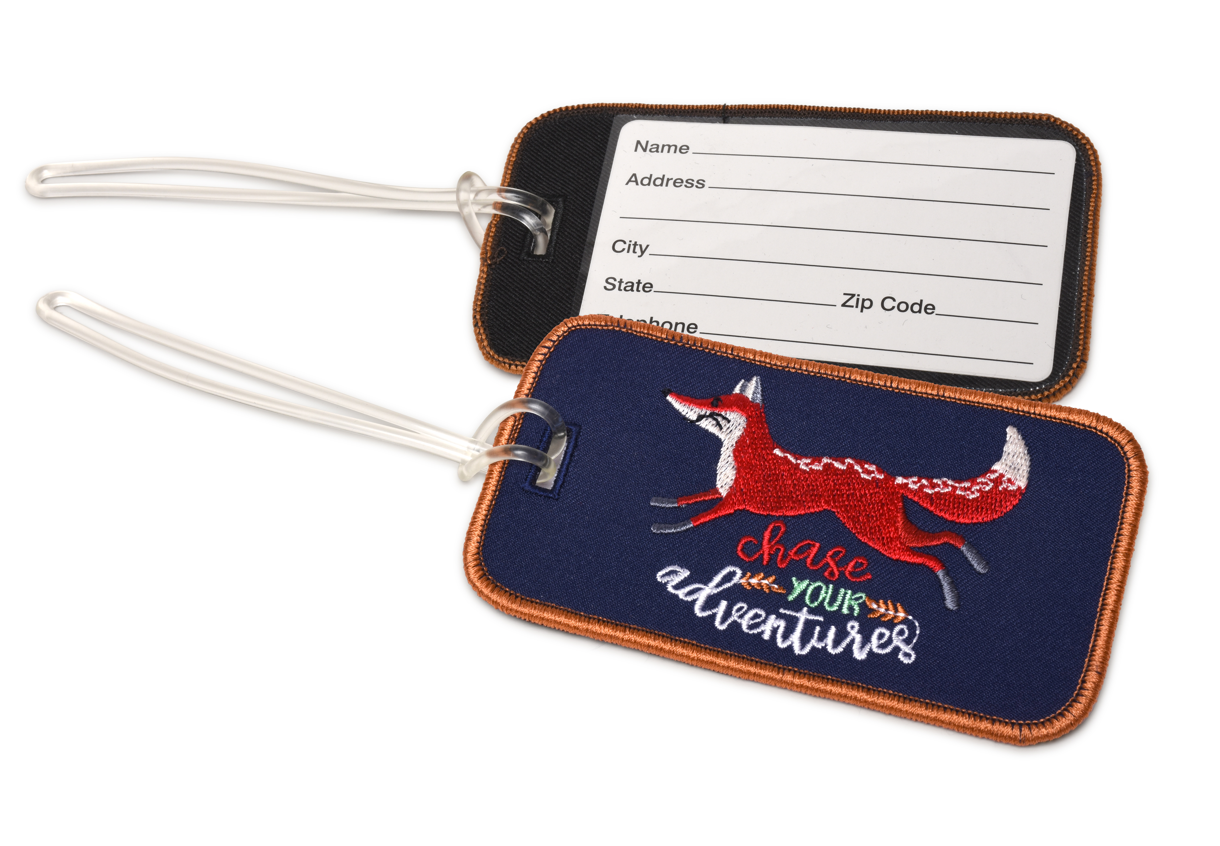

Other Rewards
Initial Order Reward
Luggage tags
To earn tags both the troop and girl must meet certain requirements:
  Troop must have 215+ per girl average at Initial Order with at least 1 box assigned to each girl
  At the end of the sale each girl in qualifying troop who sells 215+ packages will receive the reward
5000+ Incentive
Give the gift of campership For every 1500 packages a girl sells over 3,500 packages, GSCTX will donate the average camp program rate to our campership fund so that we can send more girls to camp in Summer 2020!
This is a great opportunity for girls to help fellow Girl Scouts experience the world of Girl Scout Camp!
San Francisco Trip!!!
Girls must sell 3500+ packages
Trip scheduled for July 22-26, 2020
Staff chaperoned
Parents will not be allowed to attend

Slide 39

GS Dough Information
What is it? A GIRL incentive that a girl can earn starting at the 215+ package level and above. GS Dough is non-cumulative!
What can it be used for? Troop Trips, GSUSA Destination Trip, Council Sponsored Trip, GSCTX Resident Camp, GSCTX Events/Activities, GSCTX Shop purchases and Master Property Plan (GSCTX Facilities)
How can I use it for the above items? Depends on the item!
GSCTX Shop- use directly in the shop (can’t be used online, sorry!)
Council trips, GSCTX Camp, GSCTX Events- paper event registration for events
Troop trip, Destination trip- GS Dough Activity Form that can be found on our website
What can it NOT be used for? FOGS, Girl Scout Membership Fees, SU Events, online GSUSA Store or any online store
When is it received? GS Dough is mailed out at the end of March to you, the SUCM
Does GS Dough expire? Yes, GS Dough expires in December. For specific date refer to our website.
More information visit www.gsctx.org or contact Products@gsctx.org
GS Dough is NOT for troops to hold on to or hoard! Please give out the cards to girls that earned it. GS Dough is also not for the troop to use without girl’s permission.

Slide 40
Secret Shoppers
Secret Shopper – Secret Shoppers are sent out all over council to award certificates for 12 extra packages in sales to girls at a booth. Girls earn a certificate if they are following booth rules, know their product and have cookie sale goal!
Troop and girl do not pay for the 12 extra packages.
Troop does not earn troop proceeds or cookie bonus on the Secret Shopper boxes- only a girl incentive.

Slide 41
After the Sale

Slide 42
Final Girl Reward Order
Each troop should create and save a Girl Reward Order on or by 11:59pm on Monday, March 2, 2020
Selections MUST be made for girls
C/S/A troops wanting to opt out must change proceed plans to Opt Out AND need to also create a reward order.
SU will contact you mid-late April and/or beginning of May to pick up prizes.
Any troop that does not pick up their prizes in a timely manner may risk having items donated to an organization
  Note, SU’s are not expected to hold on to items forever- please be respectful of your SUCM’s time and storage space and pick up items by their deadline.

Slide 43

Cookie Close Out
Troop Cookie Close Out paperwork is due to the SUCM by 11:59pm Monday March 2, 2020
Balance Smart Cookies so that all cookies taken in by troop are allocated to girls
Must BALANCE to 0!!!
Submit Girl Reward order by 11:59pm
Deposit all collected money into troop bank account
Submit any late Parent/Guardian forms
Download the following reports from Smart Cookies for your records:
  Troop Balance Summary
  Troop Order Summary
  Girl Cookie Order Detail Summary
  Girl Balance Summary
Complete Survey at the end of the Sale will be on www.gsctx.org and email out!
Due to Austin Service Center or Products@gsctx.org by Monday March 2, 2020
Submit Credit Card Reimbursement form ONLINE. NO paper forms accepted.
Submit all Collection & Discrepancy forms to products@gsctx.org

Slide 44
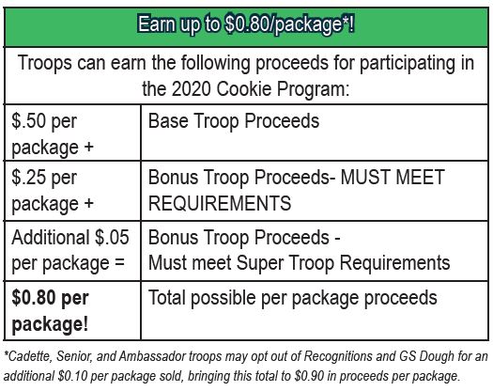
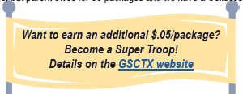
Troop Proceeds and Bonuses
Troop Proceeds - Troops earn $0.50 per package sold.
Troop Bonus – $0.25 per package sold.
  Troop Coordinator attended training
  No NSF on ANY ACH withdrawal
  Absolutely No returns
  Troop Financial Report turned in, by May 1st to MDE
    Troop Financial Report corrected by due date July 1, 2020
All must be complete for the troop to receive their bonus

Slide 45
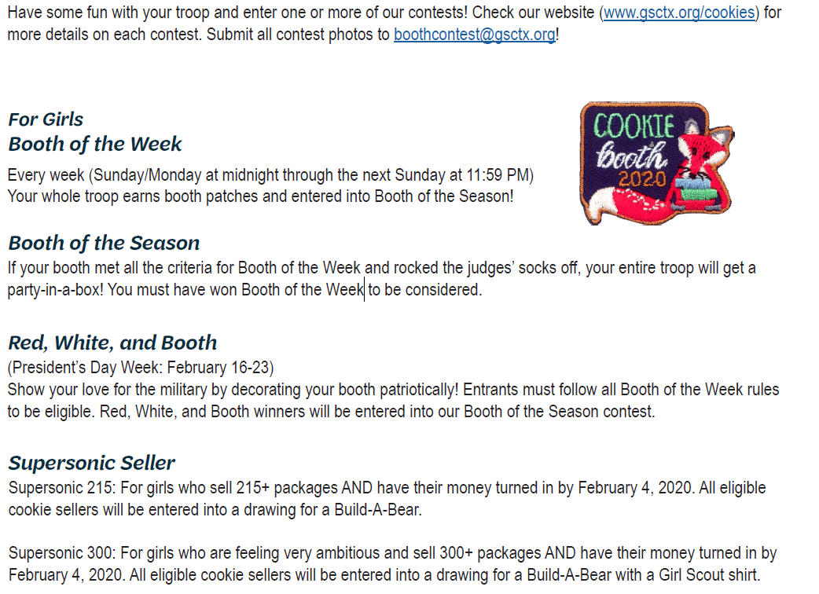
Girl Programs & Cookie Contest
Girl Programs:
Welcome to Cookies! – Saturday, November 9, 2019
Cookie Captain
  Oct. 23, 2019 Austin
  Oct 26, 2019– Kyle
  Online option available
Cookie Rally
  Dec 7, 2019 N Austin/S Austin
  Jan 12, 2020 N Austin
*** check online for exact locations of each Program

Slide 46




Cookie Pro Contest

Slide 47
Smart Cookies Training
Notes:
This slide style is TITLE STYLE A
NOTES FOR USAGE:
Adjust width and position of the white title box as needed.
Photos:
Some pre-sized images have been supplied with the template.
To change photos, select image > right click > “Change picture”.
Check out Girl Scouts photo library here: https://gsusa.box.com/s/bpioz0pyf8d40knlau8m
Avoid using Microsoft clip art: it’s off-brand and tends to look outdated and unprofessional.
If using your own photography, make sure you have secured rights to use in Girl Scout materials.
Crop and resize an image by double clicking the image. The crop tool appears in the Formatting Palette. Click on the crop tool to make adjustments.
Girl Scout Councils:
Replace the Girl Scout servicemark with your council lockup in Master page view (view > Master > Slide Master).

Slide 48

Getting started….. SMART COOKIES
Personalized based on user:
  Girl/parent
  Troop
  SU
Optimized, responsive interface for web & mobile devices
Order Management
Training
Marketing
Review: Smart Cookie Guide (on our website www.gsctx.org) & view ABC Bakers YouTube channel for video tutorials
Notes:
*Council to customize this slide

Slide 49
Smart Cookies set up
Receive Registration Email to Live Site as soon as SUCM adds troop (link expires 45 days after sent)
  Update troop Information
  Verify all registered girls are in the system
GSCTX will add all girls
  Troops/SU may not add/delete any girls in the system
  If troop has a girl that is not participating just ignore the girl- We DO NOT delete any girls from Smart Cookies
Review Smart Cookies Screenshots & ABC Bakers YouTube channel for video tutorial
Notes:
*Council to customize this slide

Slide 50

Apps & Logos
The Smart Cookies Mobile app puts all the cookie-order tools from Smart Cookies at girls’ fingertips. It’s a handy way to:
Set and track goals
View recognition levels achieved
Enter and manage cookie orders
Track order payment and delivery status
***need to re-download the app this year***
Customers can purchase cookies online and have them shipped directly to the them (shipping cost apply). New gift box option!

Slide 51
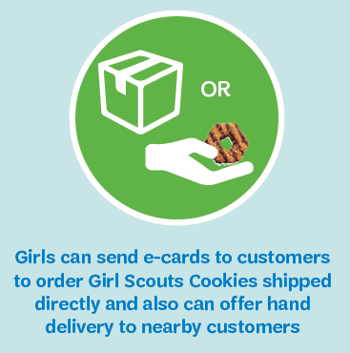

Smart Cookies Direct Ship = Doorstep Delivery to Customers!
Cookie share available (Operation Cookie- goes to Soldier’s Angels)
No shipping charges for Cookie Share purchases
$1.25 fee per Cookie Share transaction (NOT per package)
Notes:
COCOdirect helps girls and volunteers streamline their cookie sale by allowing consumers to place large orders, pay with a credit card and receive direct shipment of cookies — a great option for anyone who wants to order Girl Scout Cookies in bulk or support a family member or friend who is a Girl Scout.
What is the difference between COCOmobile and COCOdirect?
COCOmobile and COCOdirect are both related to COCO Cookie Command — one is merely the mobile version, while the other is a distinct function available on both!
COCOdirect is the functionality that allows Girl Scout cookies to be shipped directly to consumers in bulk sizes, including:
An eight-pack sampler
A half dozen of any one variety
A dozen of any one variety
COCOmobile is the app that allows girls to access all the features of COCO cookie command on their mobile devices — including placing these direct-ship orders and inputting credit card and shipping information.

Slide 52

Smart Cookies Direct Ship- Shipping Cost
# of packages | Cost
1-12 packages- flat fee | $12
1-12 packages AK/HI | Addl. $40 (added to $12)
1-12 packages APO/FPO | Addl. $10 (added to $12)
Gift Box- 5 packages | $4 gift box fee + $12
**$12 flat fee starts over after the 12 packages have been reached

Slide 53

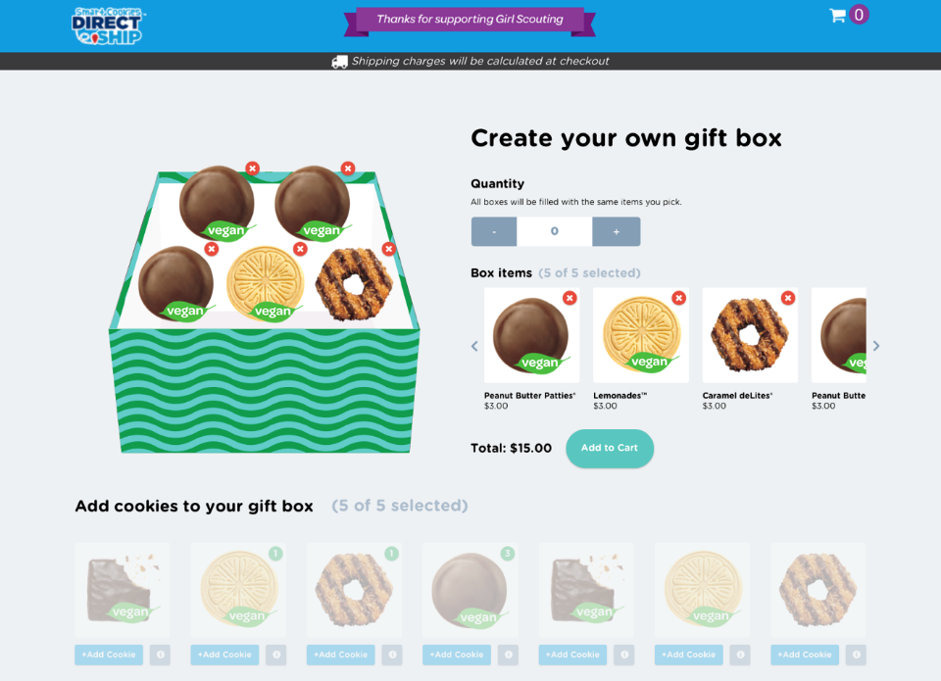
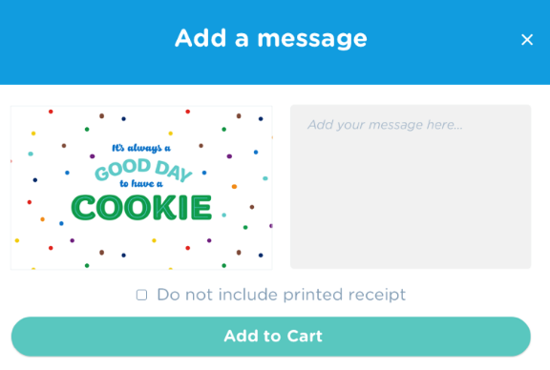
Online
Support
Customizable gift box
End consumers now have the ability to create a custom gift box of Girl Scout Cookies for the cookie lover in their lives
Consumers have the ability to hand select which five boxes of cookies they wish to include in the gift box
Consumers are also able to craft a personal note to the gift box recipient
Perfect for birthdays, care packages, Valentine’s Day or just because!
Rewards
Program
User Roles
Total Cost:
Price of cookies ($4 or $5 per package) + $4 + $12 shipping
Custom
Gift Boxes

Slide 54


Questions?

